Slide 1
Chapter 1
The Nature of Science

Slide 2
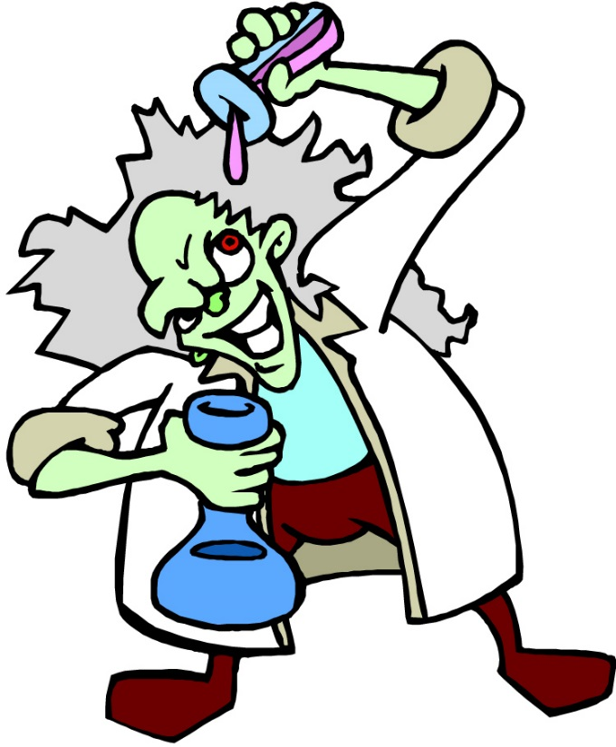
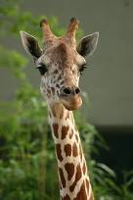
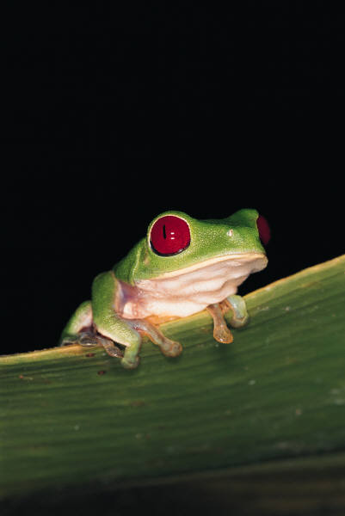
What is Science?
The goal of science is to investigate and understand the natural world, to explain events in the natural world, and to use those explanations to make useful predictions.
1. Science deals only with the natural world (so ghost hunting is not science!)
3. Scientists propose ___________ that can be ______ by examining evidence.
explanations
tested
2. Scientists:
collect and organize information in a careful, orderly way, looking for patterns and connections between events.
4. Science is an organized way of using evidence to learn about the natural world.

Slide 3


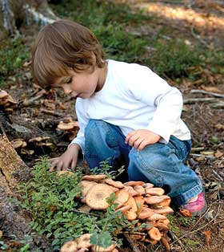
How is Science Done?
Science begins with an ___________.
This is the process of gathering information about events or processes in a careful, orderly way.
observation
Data is the information gathered from making observations.

Slide 4
1.1 Methods of science
What can science be used to explain?
  How things work, what they are made of, and where things come from
These explanations can be either theories or laws
  Theory: An explanation of why something happens based on knowledge gained from many observations and investigations
    Theories can change or be gotten rid of when science changes
  Law: Statement about what happens in nature that seems to be true all the time, but does not explain why
    Want an example? Think about what happens when you drop a pencil…
    Usually laws DO NOT change

Slide 5
1.1 Methods of science
Recap: What is the difference between a theory and a law???

Slide 6
1.1 Methods of science
Some scientific explanations change over time.
  Why???
How can we solve a scientific problem?
  The scientific method!!!

Slide 7
The Scientific Method has 6 steps
State The Problem
Gather Information
Form a Hypothesis
Analyze Data
Draw Conclusions
Test the Hypothesis
People (Problem)
In (Information)
Hawaii (Hypothesis)
Tiptoe (Test)
Around (Analyze)
Cats (Conclusions)
Hypothesis Supported? Repeat the experiment several times!
Hypothesis NOT Supported? Modify the hypothesis!

Slide 8
1.1 Methods of science
Experiments
  Models
    What are they used for?
  Variable
    A factor that can cause a change in the results of an experiment
  2 types of Variables
    Dependent: What is being tested/measured (on Y axis of a graph)
    Independent: Changed or controlled to test the effects on the dependent variable (on X axis of a graph)
    (Independent variable) causes a change in (Dependent Variable)
    Or
    Think about what variable depends on the other
    Ex: A scientist studies how many days people can eat soup until they recover from being sick.
      Independent variable: Dependent variable:

Slide 9
1.1 Methods of science
Constant vs control
  Constant: a factor that does not change when other variables change
  Control: a standard used for comparison of test results in an experiment (nothing is done to it!)

Slide 10
1.1 Methods of science
Technology
  Definitely helpful
  But is it ALWAYS helpful?
    Debate about genetic modification/engineering

